Slide 1

TIME
GYM
FOR
Ross Stewart & James Johnson

Slide 2
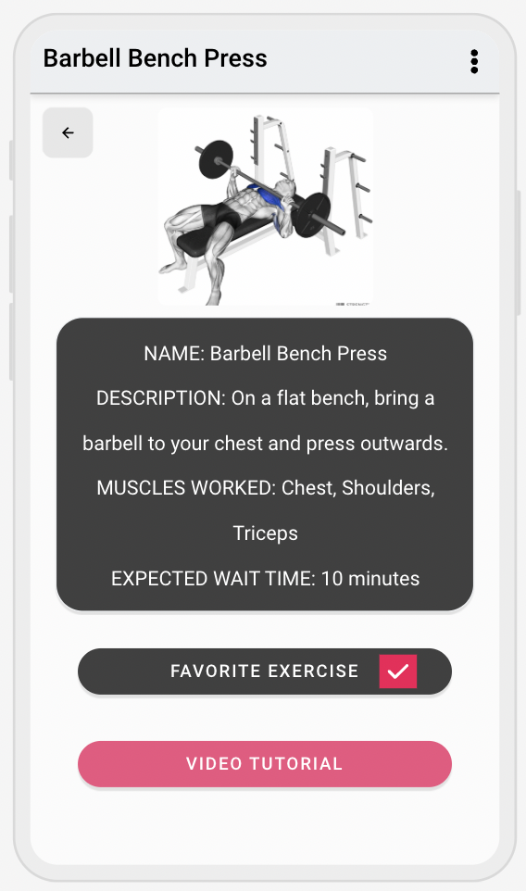
Overview
Fitness App
User account specific
“Library” of exercises
Sorted by muscle groups
Exercise information
“Favoriting” an exercise allows for quick access
Gym counter & crowd predictor

Slide 3
System Analysis
System Overview
System Diagram
Actor Identification
Design Rationale
Architectural Style
Design Pattern(s)
Framework

Slide 4
System Overview
User Interface
User can view the entire application
Controller
Controls the “behind the scenes” and allow us to show the proper information on the user interface
Gets data from the database
Database
Allows us to store exercises and the video links for them

Slide 5
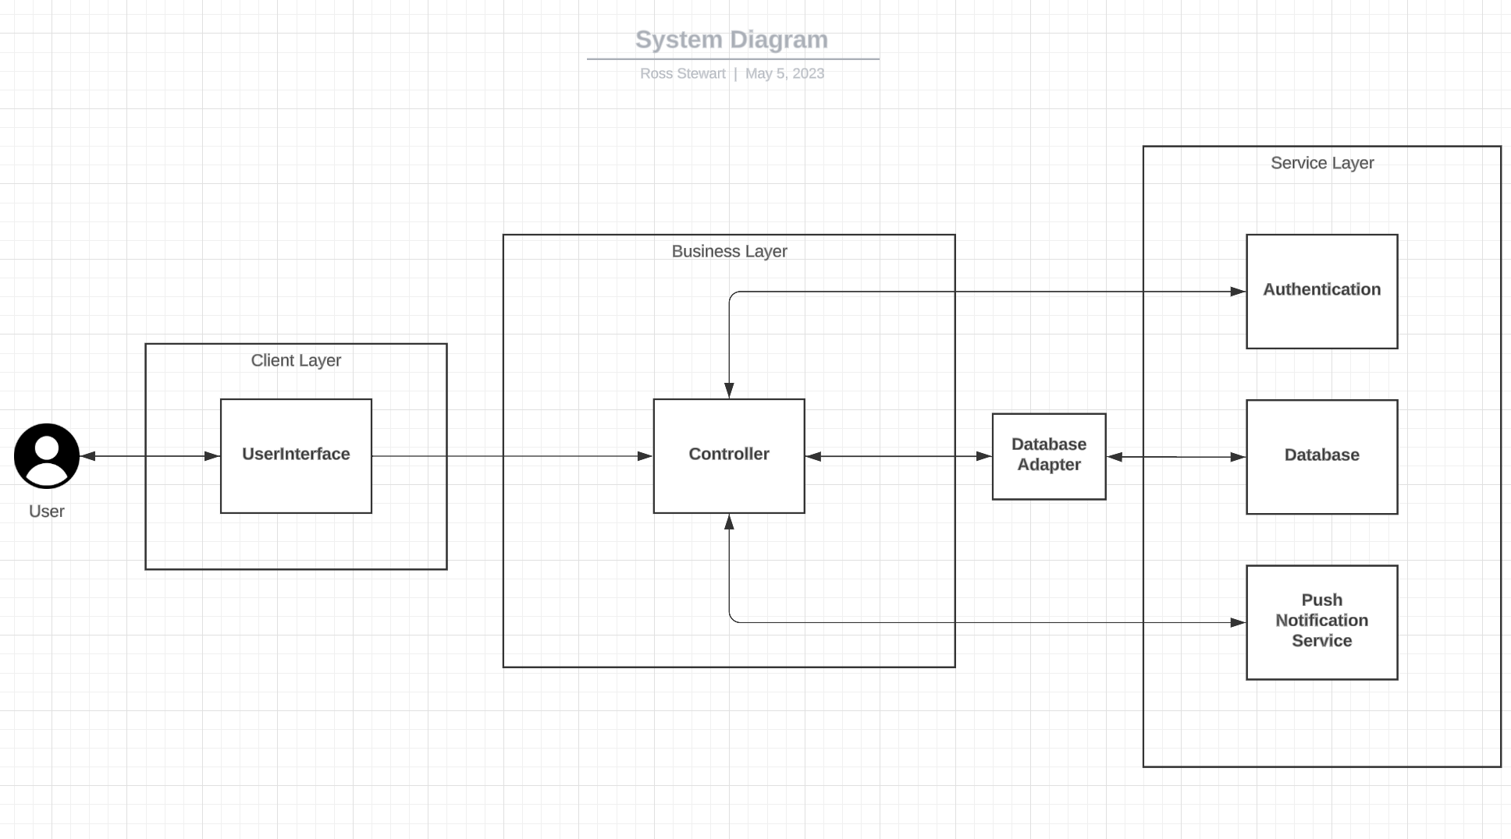
System Diagram
3 layers:
Client
The user interacts with a clean user interface
Business
Controls what goes on behind the user interface
Service
Interacts with third-party authentication (Google login)
Interacts with database (Microsoft SQL) and push notification service for device

Slide 6
Actor Identification
User
Will be allowed to view exercises and favorite them. Will also be allowed to use the wait time functionality as well as view different exercises.
System Administrator
Will be able to make changes to the system as needed and update different functions and features. Can update / add new exercises to the database.
Third party authentication/ Push Notifications
Will be allowed access to the initial login and user information to sign them in and help them save their information. This will also allow for the proper information to be sent to the proper users etc.

Slide 7
Design Rationale - Architectural Style
Three Tiered Architecture which will allow for a good client-based user interface connected to the server to retrieve our data and other information without cluttering the UI.
This will allow for use of both AWS and the React Framework for an uninterrupted user experience.
The Client tier
This would be the user interface layer
The Business logic tier
Allows us to determine the correct information to present to the user based on what they select
The Service tier
Allows for us to “talk” to our databases and provide security, this would be done with AWS.

Slide 8
Design Rationale - Design Pattern(s)
We will use the strategy design pattern which will allow us to manipulate data, predictions, and analysis all within our back end.
We will also use the singleton design pattern, which will be used to help is manage the database connections and other shared resources.
We will also use the façade design pattern which will allow for a simple interface for the complex systems. This will hide the complexity of the server side services from the client
To achieve these goals we must use different algorithms interchangeably.

Slide 9
Design Rationale - Framework
React Native
It is well known and documented, and allows us flexibility.
It will also allow us to develop the app for the different platforms we plan to release it on with ease.
React is also easy to combine with APIs and AWS which is another big part of making this app work.
Microsoft SQL Database Server
Well known and documented
Allows user access to our application
Stores our data securely and remotely
System will operate smoothly and efficiently

Slide 10
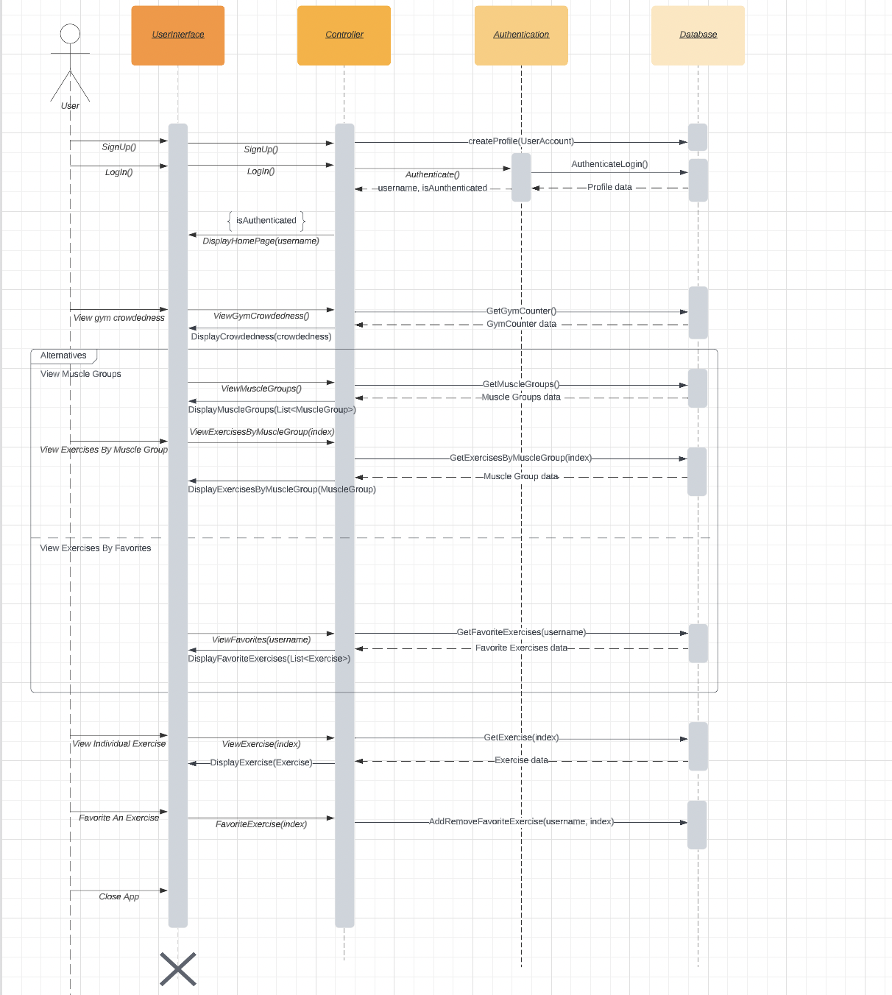
Functional Design
Sequence Diagram - Entire application
Sign up / Log in
Home page

Slide 11
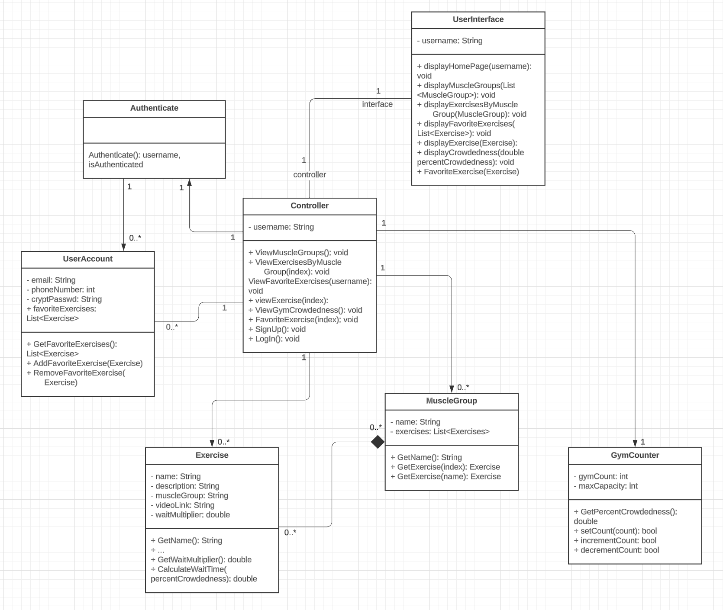
Structural Design
Classes
Controller
UserInterface
UserAccount
Authenticate
MuscleGroup
Exercise
GymCounter

Slide 12
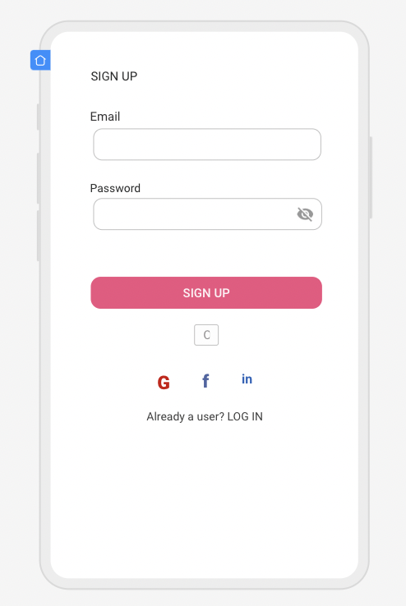
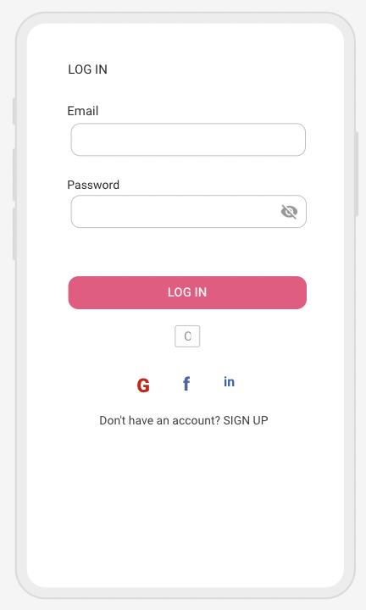
Mockup
Sign up
Log in

Slide 13
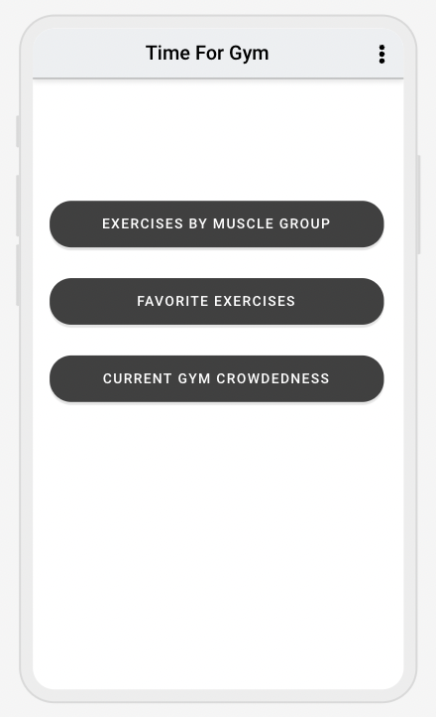
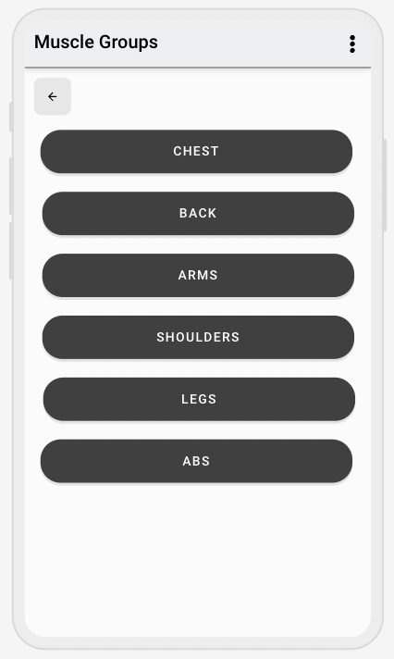
Mockup
Home page
Muscle Groups

Slide 14
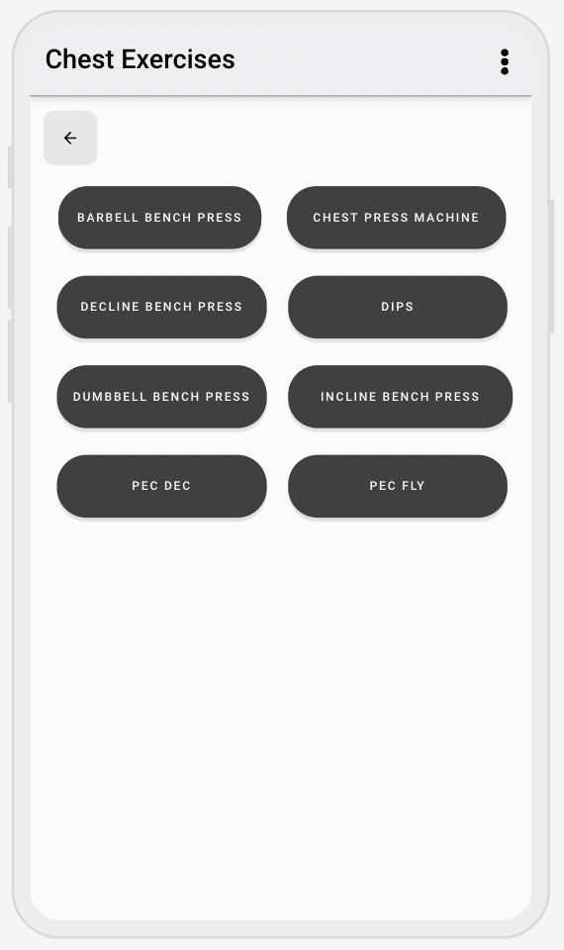
Mockup
Exercises by Muscle Group
Individual Exercise

Slide 15
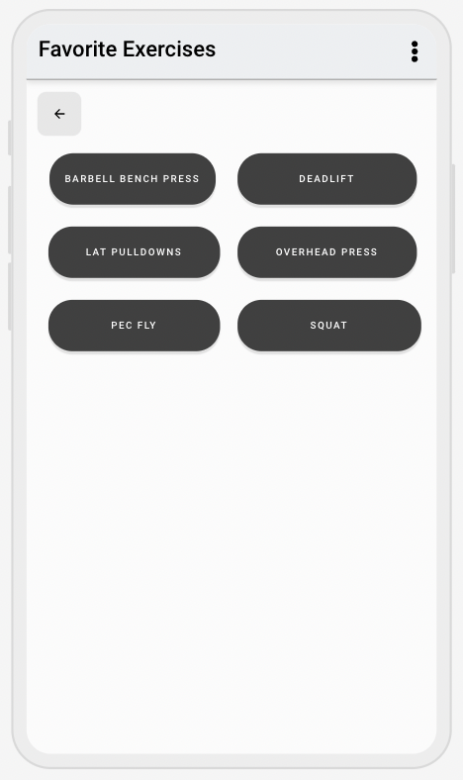
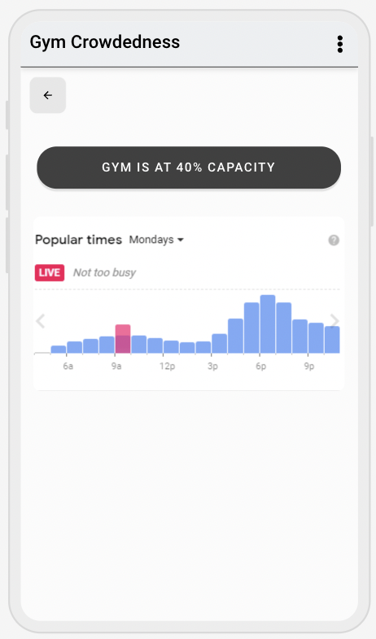
Mockup
Favorite Exercises
Gym Crowdedness

Slide 16
Questions?

